Slide 1


Data Analysis And Visualization

Slide 2


Today's agenda
Project recap
Problem
The Analytics team
Process
Insights
Summary

Slide 3

Social Buzz is a fast growing technology unicorn that need to adapt quickly to its global scale. Accenture has begun a 3 month POC focusing on 3 tasks:
An audit of social buzz big data practice
2. Recommendations for IPO
3. Analysis to find Social Buzz top 5 most powerful categories of content
Project Recap

Slide 4

Problem
looking to complete an IPO by the end of next year and need guidance to ensure that this goes smoothly.
still a small company and do not have the resources to manage the scale that they are currently at. They could hire more people, but they want an experienced practice to help instead.
want to learn data best practices from a large corporation.

Slide 5
Data Analyst
{Riwaj Neupane}
The Analytics team
Andrew Fleming (Chief Technical Architect)
Marcus Rompton (Senior Principle)

Slide 6
Data Understanding
Process
1
Data Cleaning
2
Data Modeling
3
Data Analysis
4
Uncover Insights
5

Slide 7
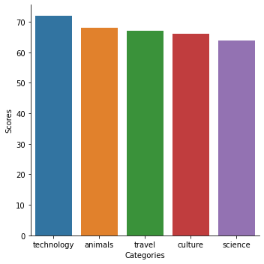

Insights
Top 5 Categories By Score:

Slide 8
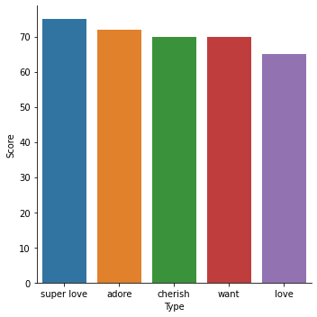

Slide 9
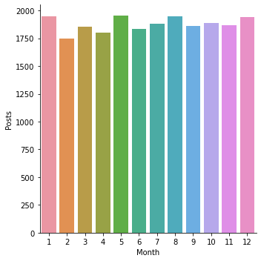

Slide 10

Performed Data Analysis to:
Find top 5 reactions
Find posts distribution among months of a year
Summary

Slide 11
Thank you!
ANY QUESTIONS?

